Slide 1
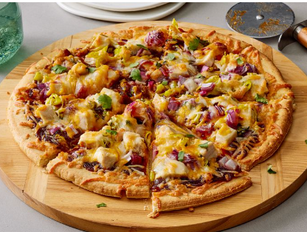
PIZZA SALES ANALYSIS
Presented by:
Geetha Potuka

Slide 2
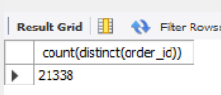
1.Retrieve the total number of orders placed ?
Code:
Select count(distinct(order_id)) from order_details;

Slide 3

2.Calculate the total revenue generated from pizza sales?
Code:
Select sum(o.quantity*p.price ) as total_revenue from order_details o join pizza p on o.pizza_id=p.pizza_id;

Slide 4

3.Identify the highest priced pizza?
Code:
select p.pizza_id, t.name, p.price from pizzas p join pizza_types t on p.pizza_type_id = t.pizza_type_id ORDER BY p.price DESC LIMIT 1;

Slide 5

4. Identify the most common pizza size ordered?
Code:
SELECT p.size, COUNT(*) AS order_count FROM order_details o JOIN pizzas p ON o.pizza_id = p.pizza_id GROUP BY p.size ORDER BY order_count DESC LIMIT 1;

Slide 6
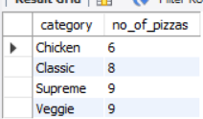
5. Find the category-wise distribution of pizzas?
Code:
SELECT category, COUNT(DISTINCT pizza_type_id) AS no_of_pizzas FROM pizza_types GROUP BY category ORDER BY no_of_pizzas;

Slide 7
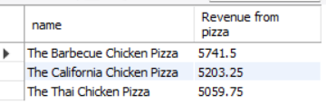
6. Determine the top 3 most ordered pizza types based on revenue ?
Code:
SELECT pizza_types.name, SUM(order_details.quantity * pizzas.price) AS `Revenue from pizza`FROM order_details JOIN pizzas ON pizzas.pizza_id = order_details.pizza_id JOIN pizza_types ON pizza_types.pizza_type_id = pizzas.pizza_type_id GROUP BY pizza_types.name ORDER BY `Revenue from pizza` DESC LIMIT 3;

Slide 8
THANK YOU

